Slide 1

NourishNet: A Smart Food Waste Redistribution and Resource Management Platform
Presented by:
Juhi Surin (192525148)
Pranayaa S (192524110)
S Spandana (192525160)
Lakshmi Vani (192365018)
Under the Supervision of:
Dr. R. Latha

Slide 2


Introduction
Food waste is a major global issue, while many people still face food insecurity due to inefficient food distribution.
NourishNet is a smart web-based platform that connects food donors with NGOs and volunteers.
The system enables real-time food donation, resource management, and delivery tracking.
It reduces food wastage through efficient redistribution and coordinated logistics.
The platform promotes social responsibility by ensuring surplus food reaches people in need safely and quickly.

Slide 3

Objectives
Develop a centralized web platform for managing food donations and redistribution.
Enable secure user registration with role-based access for Donors, NGOs, Volunteers, and Admins.
Automate food donation, recipient matching, delivery assignment, and real-time tracking.
Improve transparency through dashboards, reports, feedback, and administrative monitoring.
Reduce food wastage by ensuring timely and efficient redistribution of surplus food.

Slide 4
Literature Survey
Year | Author(s) | Paper / Publication Name | Discovery
2026 | Maleki Vishkaei & De Giovanni | Smart Food-Sharing Platforms for Social Sustainability: A Heuristic Algorithm Approach | Proposed a smart food-sharing platform using a heuristic algorithm to improve food redistribution and promote social sustainability.
2026 | V. Seedha Devi, D. Selvi, K. Uma Maheshwari & G. Yuvashree | Food Linker: A Smart System for Global Waste Reduction | Developed a smart system connecting food donors and recipients to reduce food waste efficiently.
2025 | Swathi, Reddy & Palukuru | A Comprehensive Analysis: Smart Food Waste Management System | Presented a smart food-waste management system with effective donation and inventory management.
2025 | Vijay K., Dhanush Ishwar D., Thilak Kumar V., Srinidhi D. & Ujjain S. | Serve Surplus: A Smart Food Redistribution Platform for Reducing Urban Food Waste and Combating Hunger | Designed a food redistribution platform that reduces urban food waste and combats hunger through digital coordination.
2024 | Bharani, Mohanraj, Sujith & Vinothkumar | Optimizing Surplus Food Management: A User-Centric Application Approach | Proposed a user-centric surplus food management application to simplify food donation and improve resource utilization.
Year | Author(s) | Discovery
2026 | Maleki Vishkaei & De Giovanni | Proposed a smart food-sharing platform using a heuristic algorithm to improve food redistribution and promote social sustainability.
2026 | Devi, Selvi, Maheshwari & Yuvashree | Developed Food Linker, a smart system that connects donors and recipients to reduce global food waste efficiently.
2025 | Swathi, Reddy, Palukuru & Reddy | Presented a comprehensive smart food waste management system with effective donation and inventory management.
2025 | Vijay, Kumar, Srinidhi, Ujain & Ujain | Designed Serve Surplus, a food redistribution platform that reduces urban food waste and combats hunger through digital coordination.
2024 | Bharani, Mohanraj, Sujith & Vinothkumar | Proposed a user-centric surplus food management application to simplify food donation and improve resource utilization.

Slide 5
Existing system vs Proposed system
Existing System | Proposed System
Food donations are managed manually. | Fully automated web-based platform.
Limited communication between donors and NGOs. | Real-time communication and notifications.
No efficient tracking of donations. | Live donation and delivery tracking.
Manual record maintenance. | Centralized digital database management.
No analytical reports available. | Dashboard with reports, statistics, and feedback.

Slide 6
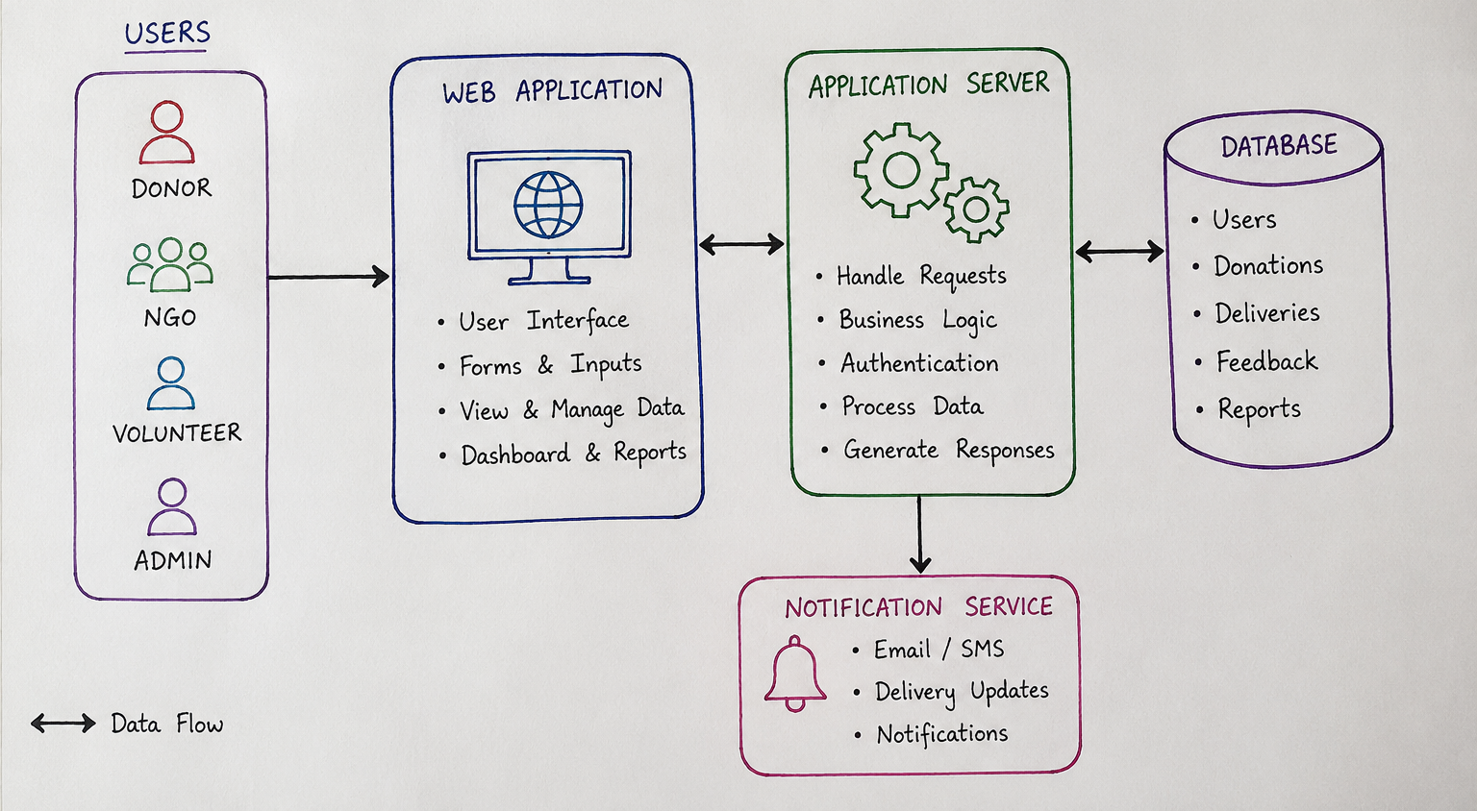
System Architecture

Slide 7
Tools used
Frontend: HTML, CSS, JavaScript, Bootstrap.
Backend: PHP.
Database: MySQL.
Development Environment: Visual Studio Code and XAMPP.
Version Control & Design: GitHub and Figma.

Slide 8
Module 1 – User & Organization Management
This module manages user registration, authentication, and secure login functionality.
It provides role-based access for Donors, NGOs, Volunteers, and Administrators.
Users can create, edit, and manage their personal and organizational profiles.
Organizations can register and undergo verification before accessing the platform.
User information is stored securely using authentication and database management techniques.

Slide 9
Module 2 – Food Donation & Resource Management
Donors can add food donation details, including quantity, type, and expiry date.
The system maintains an updated inventory of available food resources.
Donation availability and status are updated in real time.
Users can view previous donation records and history.
CRUD operations and input validation ensure accurate resource management.

Slide 10
Module 3 – Smart Distribution & Delivery Management
The system matches food donations with nearby NGOs based on location.
Volunteers are assigned automatically for food pickup and delivery.
Pickup and delivery progress are tracked in real time.
Notifications are sent to all users regarding delivery updates.
Status tracking improves delivery efficiency and transparency.

Slide 11
Module 4 – Analytics, Feedback
& Administration
The dashboard displays donation statistics, user activity, and delivery performance.
Users can submit feedback and rate the quality of services.
Administrators monitor users, donations, and platform activities.
Reports are generated to evaluate overall system performance.
Admin approval ensures secure and reliable platform management.

Slide 12

Advantages
Reduces food wastage through efficient redistribution.
Improves coordination between donors, NGOs, and volunteers.
Provides real-time tracking and status updates.
Ensures secure and transparent data management.
Generates reports and analytics for better decision-making.

Slide 13
Applications
NGOs and charitable organizations.
Restaurants, hotels, and catering services.
Educational institutions and hostels.
Corporate social responsibility (CSR) initiatives.
Community food banks and disaster relief programs.

Slide 14

Future Scope
Integrate AI to predict food demand and optimize donation matching.
Develop a mobile application for Android and iOS users.
Implement GPS-based live vehicle tracking for deliveries.
Introduce multilingual support for wider accessibility.
Expand the platform to support nationwide food redistribution.

Slide 15
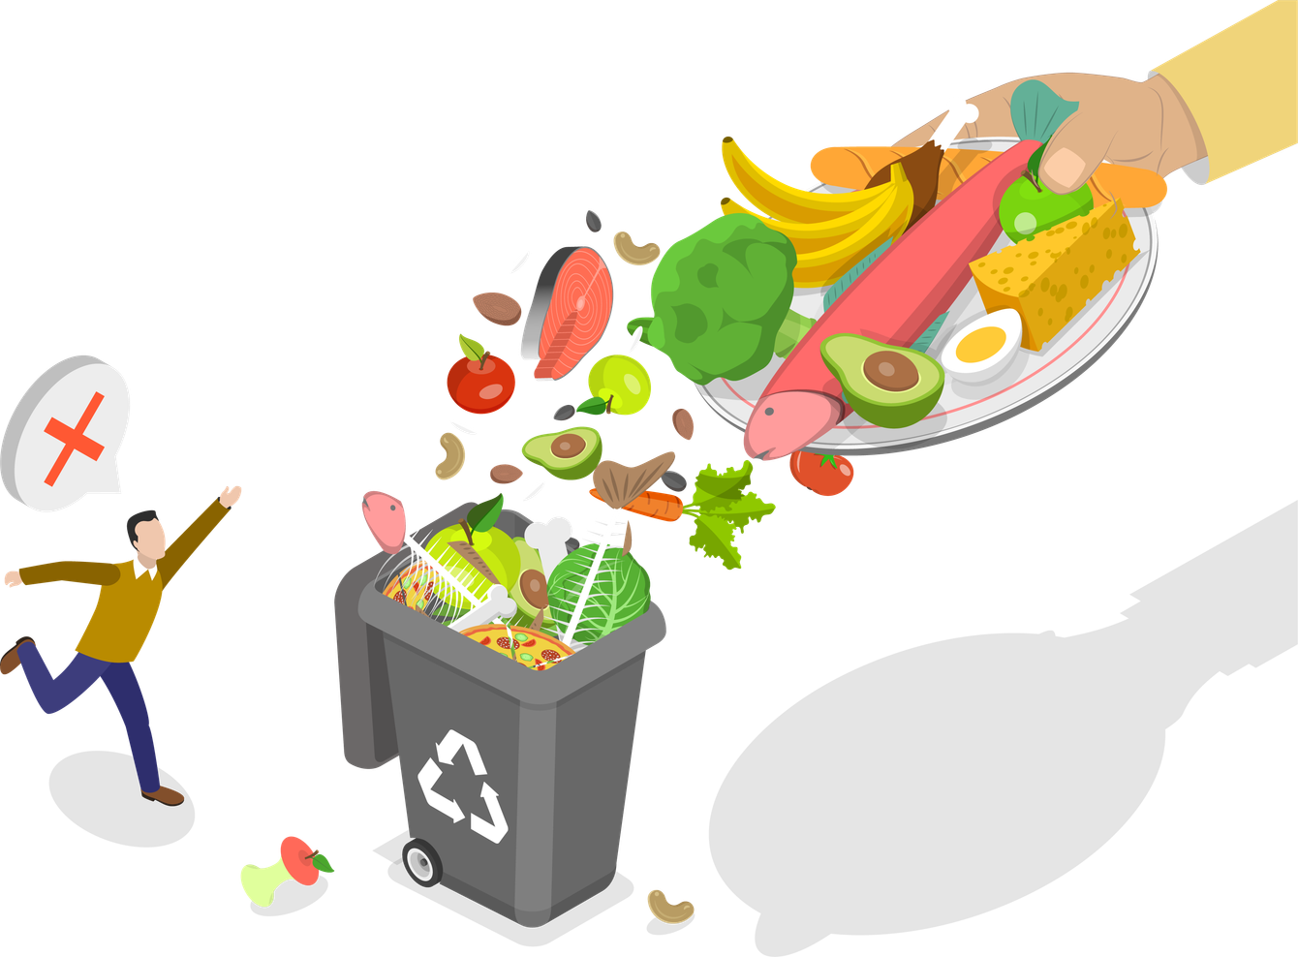
Conclusion
NourishNet provides an effective solution for reducing food wastage through digital technology.
The platform connects donors, NGOs, volunteers, and administrators on a single system.
Real-time donation management and delivery tracking improve operational efficiency.
Analytics and feedback features enhance transparency and service quality.
Overall, the proposed system contributes to sustainable food distribution and social welfare.

Slide 16
References
Maleki Vishkaei, B., & De Giovanni, P. (2026). Smart food‐sharing platforms for social sustainability: A heuristic algorithm approach. International Transactions in Operational Research, 33(5), 2893-2920.
Devi, V. S., Selvi, D., Maheshwari, U., & Yuvashree, G. (2026). Food linker: A smart system for global waste reduction. International Journal of Engineering & Extended Technologies Research (IJEETR), 8(3), 5012-5021.
Swathi, B., Reddy, I., Palukuru, S. A., & Reddy, S. P. (2025, October). A comprehensive analysis: Smart food waste management system. In 2025 10th International Conference on Communication and Electronics Systems (ICCES) (pp. 1703-1707). IEEE.
Bharatha, B. K. (2025). AI-Augmented Redistribution: Human-AI Collaboration to Prevent Waste and Feed Communities. Journal of Computer Science and Technology Studies, 7(10), 120-127.
Vijay, K., Kumar, T., Srinidhi, D., & Ujjain, S. (2025, August). Serve Surplus: A Smart Food Redistribution Platform for Reducing Urban Food Waste and Combating Hunger. In 2025 3rd International Conference on Sustainable Computing and Data Communication Systems (ICSCDS) (pp. 1734-1738). IEEE.
Bharani, S., Mohanraj, E., Sujith, M., & Vinothkumar, P. (2024, February). Optimizing surplus food management: A user-centric application approach. In 2024 Second International Conference on Emerging Trends in Information Technology and Engineering (ICETITE) (pp. 1-6). IEEE.
Chakraborty, S., Sharma, A., Raj, S., & Singh, N. (2025, February). A Smart Waste Food Management and Donation Platform Leveraging Machine Learning and Web Technologies. In International Conference On Innovative Computing And Communication (pp. 549-564). Singapore: Springer Nature Singapore.

Slide 17
THANK YOU

